Slide 1

Predictive Classification Modeling of Real Estate Pricing Tiers
Presented by Laxmi S. Rapolu, Daniel Shifrin, and Outhai Xayavongsa
University of San Diego
AAI-501 Introduction to Artificial Intelligence
Professor David Friesen
April 15, 2024
Notes:
Welcome, everyone! Let's dive into the world of Predictive
Classification Modeling for Real Estate Pricing Tiers,
presented by Laxmi, Daniel, and Outhai.

Slide 2
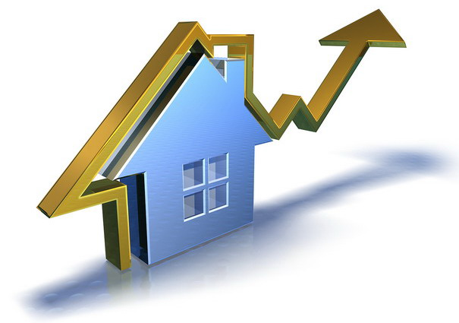
History of the U.S Housing Market
Highest rate of homeownership at 80%
2007 to 2010
Risky Lending
Home Ownership by 67.9%
Baby Boomers
Recession
Pandemic
(Marx, 2024)
(Rothstein et al., 2024)
1970s
2006
2008
2012
2020
Peak
Recovery
Housing Boom
Late 2012
This Photo by Unknown Author is licensed under CC BY-NC-ND
Notes:
Welcome to our exploration of the U.S. housing market's evolution over fifty years.
Starting in the '70s, Baby Boomers pushed homeownership rates to an all-time high of 80%.
The 2006 peak signaled a housing boom, which swiftly led to the 2008 recession due to
high-risk lending. After a period of recovery post-2012, the 2020 pandemic reshaped our
living needs, accelerating the quest for spacious homes and pushing ownership rates to 67.9%.

Slide 3
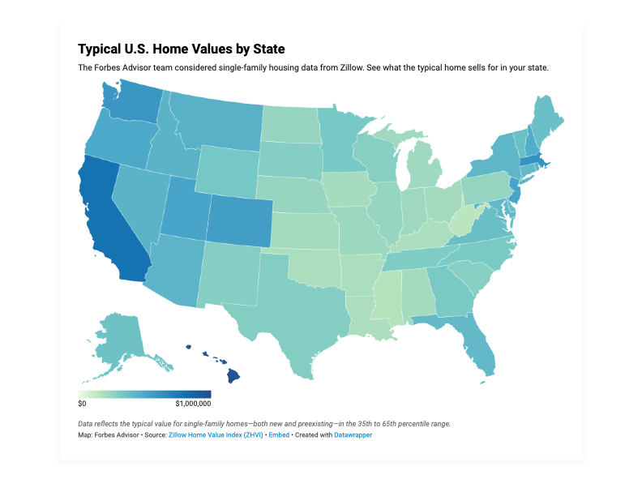
Market Analysis
Analyze 2 Million Properties
Challenges of High Prices
Focus on Key attributes
Actionable Insights for navigating
Aid in making informed decisions
Figure 1: ("Typical U.S. Home Values by State," 2024)
(Shakib, 2024)
Notes:
Our deep dive into over two million property listings tackles
the big question: How can we navigate high prices in today’s market?
By concentrating on crucial property features, our analysis
delivers actionable insights that empower stakeholders.
The goal is to cut through market complexity and provide support
for making informed, strategic decisions. Let's now delve deeper into how we
harness data to drive intelligent real estate decisions, one pricing tier at a time.

Slide 4

Prepare Data for Analysis
Remove Irrelevant
Fill Missing
Eliminate Duplicates
Outlier Handling
Encode Categories
Validate Consistency
Confirm Integrity
Notes:
Beginning with a robust cleaning of our dataset, we eliminated irrelevant information, like outdated listings, and filled missing values, employing medians for numerical data and modes for categories. To ensure the integrity of our analysis, we removed duplicate entries and outliers, such as extreme property prices outside the normal range.
We standardized our numerical data for consistency and transformed categorical variables into a machine-readable format. Careful feature selection was crucial, with an emphasis on variables heavily impacting property value, like location and amenities.
Each preparation step was validated to maintain our dataset’s accuracy.
These meticulous efforts provided us with a trustworthy foundation to effectively
analyze and classify real estate pricing tiers.

Slide 5




Pricing Tiers
Starter Homes
Executive Properties
Affordable
Below 300k
First-time buyers
Upscale Living
500-1 Mil
Modern & Luxury
Family Homes
Luxury Estates
Mid-Range
300-500k
Spacious Living
High-End
1 Mil +
Premium Amenities
Notes:
We segmented over two million listings into pricing tiers tailored to different buyer needs. Starter Homes cater to first-time buyers with prices under $300k, offering affordability.
Family Homes, ranging from $300k to $500k, provide space for growth.
Executive Properties deliver luxury and modern, for $500k to $1M.
At the top, Luxury Estates boast high-end features over $1M. This classification simplifies understanding the market, helping stakeholders make informed choices based on budget and desired amenities.

Slide 6

Exploratory Data Analysis
Dataset After Removing Outliers
Dataset Overview
The dataset with outliers includes about 2 million properties, with an average price of around $537,725.
Most properties have 3 bedrooms and 2 bathrooms
The most common city and state are Houston and Florida, respectively.
The most common pricing tier is "Starter Homes (Tier 1)".
After removing outliers, the dataset includes about 1.38 million properties, with an average price of around $323,319.
The sizes of the lot and the house are generally smaller, but Houston and Florida remain the most common city and state.
"Starter Homes (Tier 1)" remains the most common pricing tier.
Notes:
Thanks Thai! now we’ll be taking a closer look at USA property dataset used for pricing tier prediction through exploratory data analysis. Initially, the dataset included around 2 million properties, with an average price of $537,725. The majority featured 3 bedrooms and 2 bathrooms, predominantly located in Houston and Florida, classified mainly as 'Starter Homes (Tier 1)'. After outlier removal, the dataset shrank to approximately 1.38 million properties, and the average price dropped to $323,319. Despite a decrease in property size, Houston and Florida continue to be prominent locations, and 'Starter Homes (Tier 1)' remains the most common pricing tier. This analysis is crucial for a deeper understanding of the property market, enabling more informed decision-making.

Slide 7
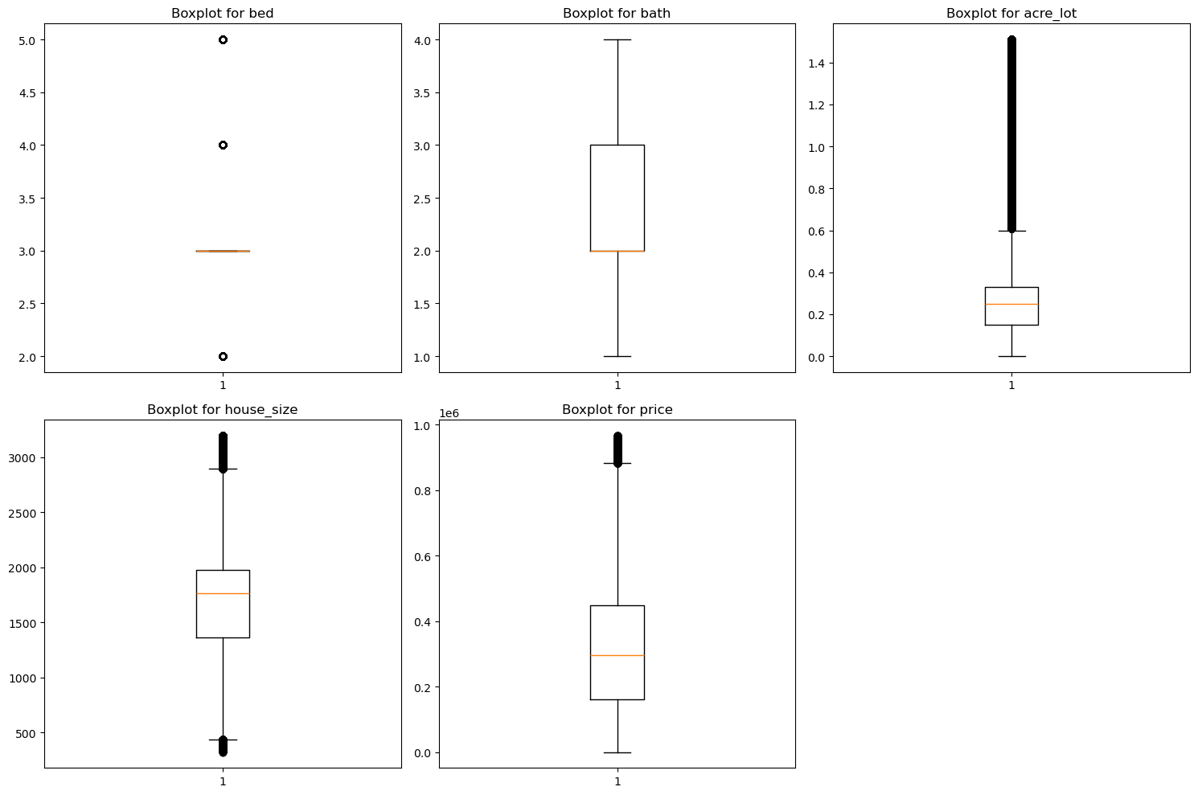
Box Plots Analysis
The box plots illustrate the distribution of five variables: bed, bath, acre_lot, house_size, and price.
They serve as valuable tools for pinpointing outliers and gaining insights into the data's distribution.
Each plot shows the median, the interquartile range, and the range, providing information about the variability and skewness of the data.
Notes:
Box plots provide a visual summary of five key real estate variables, offering insights into the market's distribution. They reveal that most properties feature 2-5 bedrooms and 1-4 bathrooms, with lot size, house size, and price typically on the lower end, yet a minority showcase significantly higher values. This skewness towards smaller and more affordable properties, with notable exceptions, is crucial for understanding market trends and buyer preferences.

Slide 8
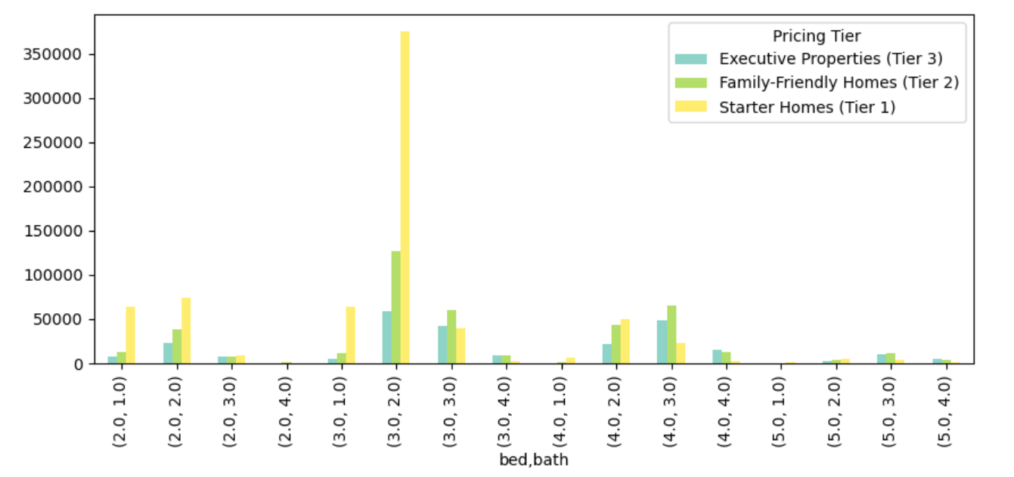
Pricing Tiers Analysis
The graph shows the pricing tiers of different types of homes based on their bedroom and bathroom count.
There seems to be an unusual spike in the price for Starter Homes with 3 bedrooms and 2 bathrooms. This could indicate a higher demand or value for such properties.
Notes:
The graph illustrates a distinct trend in the housing market, where Starter Homes with 3 bedrooms and 2 bathrooms are priced notably higher than other categories. This could indicate a higher demand or value for such properties.

Slide 9
Inferential Statistics
Chi-Square Test Results
The Chi-Square test results indicate that there is a significant association between the Pricing Tier and each of the other variables (bed, bath, acre_lot, house_size, price, city, and state)
This suggests that the Pricing Tier of a property is likely to correlate with or be linked to these other attributes.
Notes:
The Chi-Square test reveals a significant link between a property's Pricing Tier and its key features such as bedrooms, bathrooms, lot and house size, price, and location. This means that these characteristics tend to vary in relation to the property's pricing category. For example, properties in higher Pricing Tiers, like luxury homes, generally have more bedrooms and larger spaces, reflecting their premium status compared to more modestly priced starter homes.

Slide 10
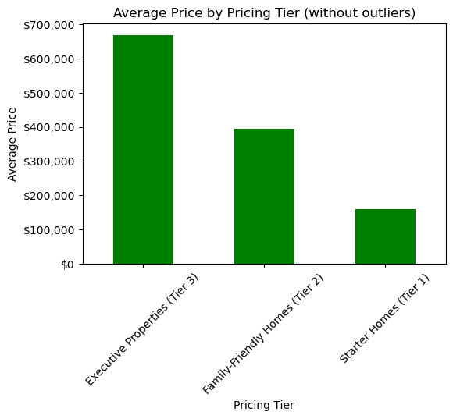
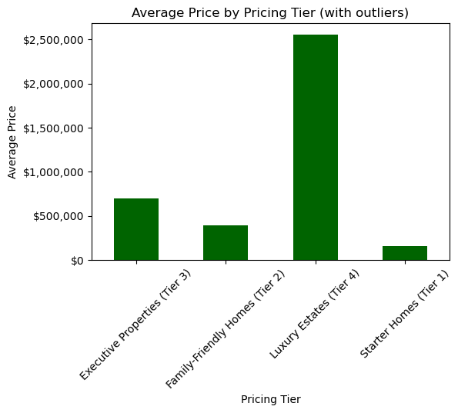
Pricing Tiers Comparison – Bar Chart
Executive
Luxury
Starter
Eliminating Outliers eliminates the Luxury Estates
Notes:
Thanks to Laxmi's groundwork, we see two distinct market profiles.
The left chart shows Executive properties as premium without outliers,
while Starter Homes remain accessible.
On the right, reintroducing outliers, Luxury Estates prices skyrocket, highlighting
a niche of ultra-high-end properties and illustrating the dramatic impact outliers
have on market analysis.

Slide 11
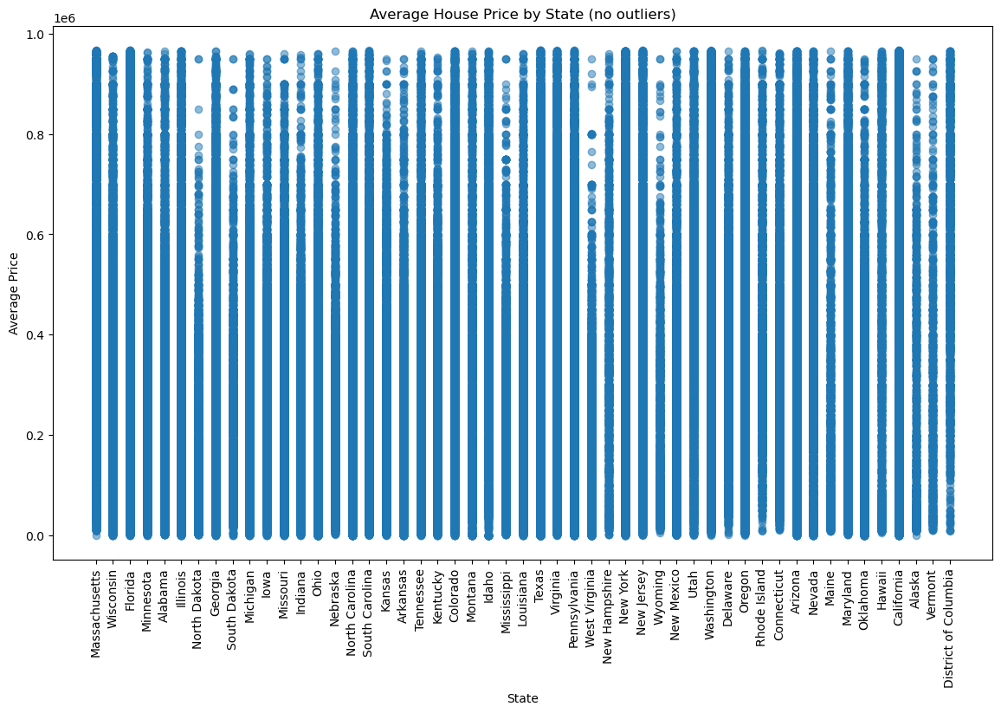
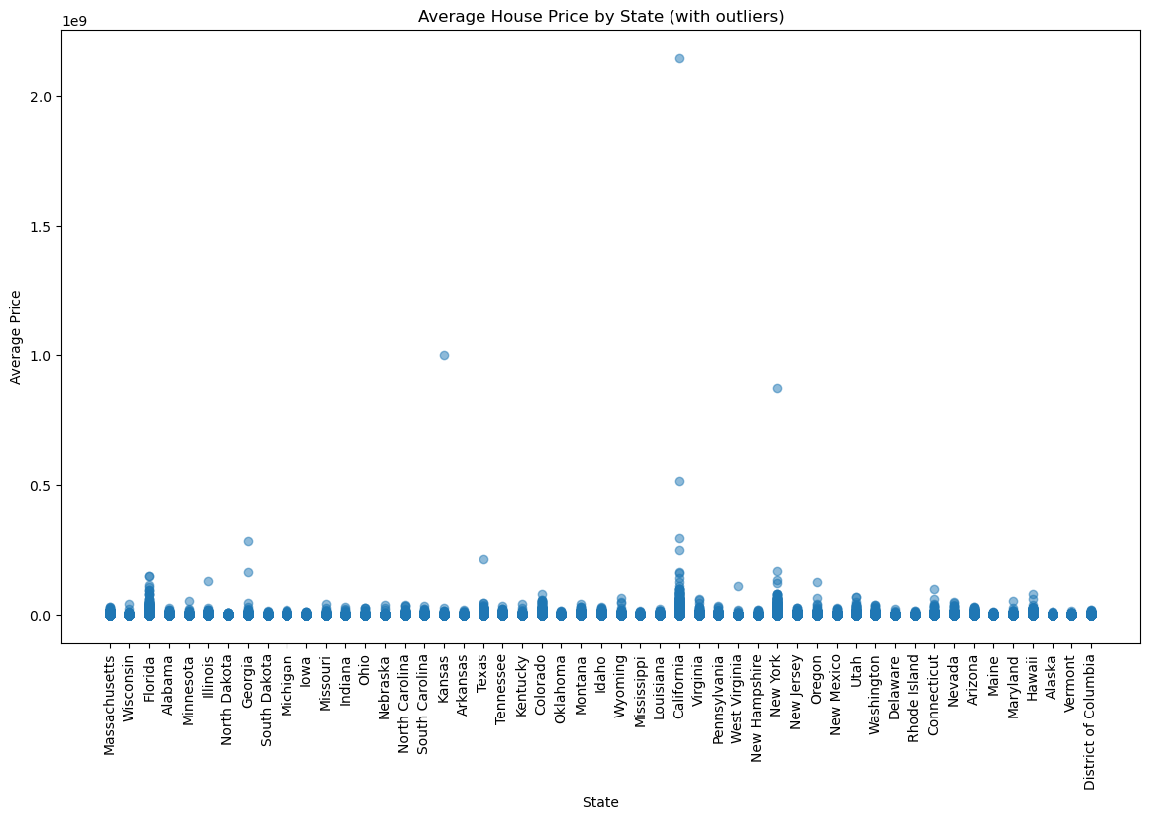
Pricing Tiers Comparison – Scatterplot
$2.5 Mil+
$1 Mil+
No Outliers
Outliers
Notes:
Previously, the bars offered a broad overview of pricing tiers. However,
the scatterplot, particularly on the right, illustrates how outliers can skew
average prices, misleadingly suggesting a higher market value.
The scatterplot on the left, devoid of outliers, presents a more typical market
scenario. By excluding luxury estates priced above 1 million, it offers a more
realistic perspective for our analysis. This visual comparison is crucial for accurate
market appraisal and strategic decision-making.

Slide 12
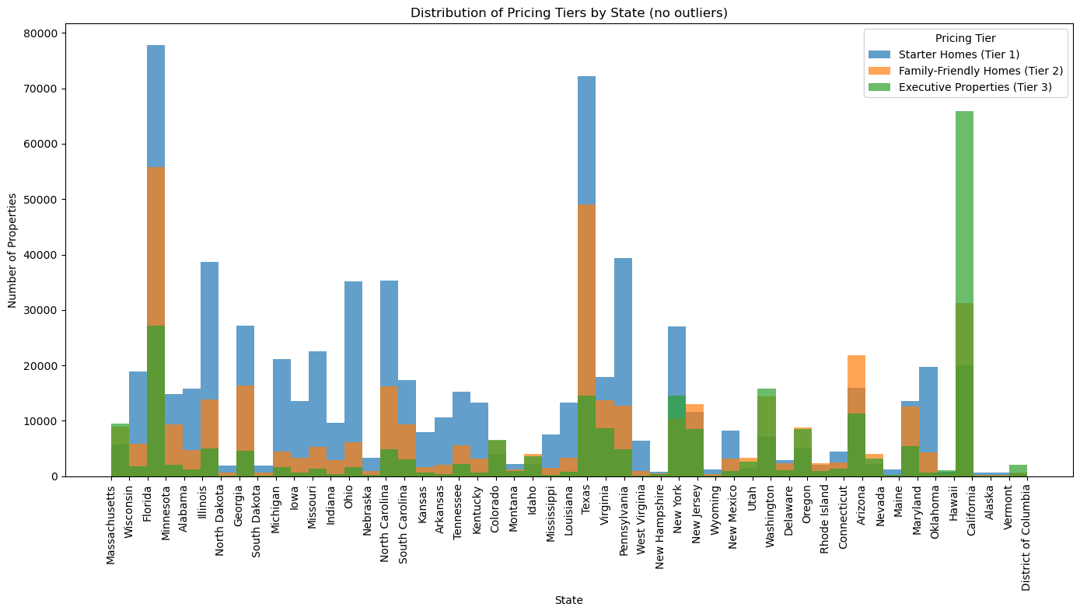
Thriving Real Estate Sectors
Florida
California
Texas
Notes:
In California, the property values clustering between $500,000 and $1 million
exemplify a competitive market driven by a robust economy and strong demand.
This range suggests a high valuation of Californian lifestyle and amenities.
Florida and Texas, however, are drawing in families and first-time homeowners
with their more accessible real estate options, perhaps influenced by economic
Incentives and a growing housing inventory.
These regional distinctions provide a barometer for market health and pinpoint
hotspots for investment and growth, guiding buyers and investors towards informed decisions in a landscape of varied opportunities.

Slide 13
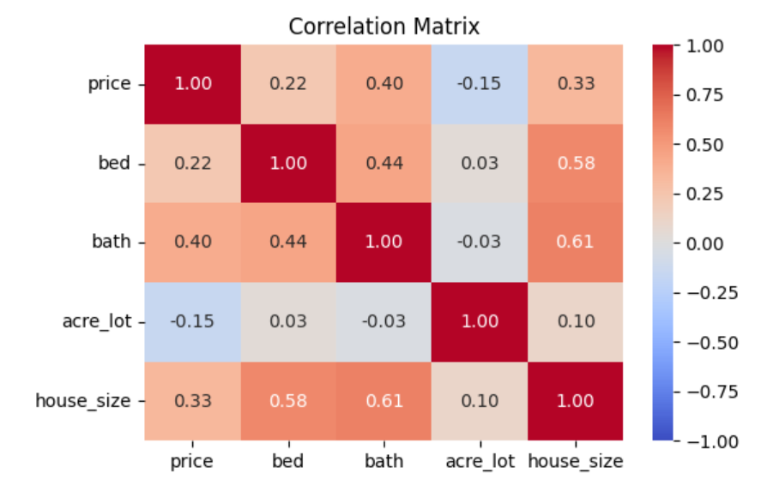
Feature Selection

Slide 14
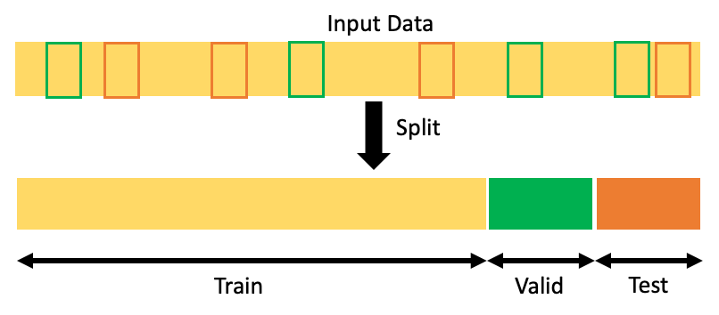
Data Split

Slide 15
Random Forest vs Gradient Boosting
76%
89%
83%
Average Precision
Positive Predictive Value
GBC
68%
RFC
64%
RFC
RFC
GBC
Accuracy
73%
AUC-ROC
Measures number of correct predictions
GBC
Distinguishing classes in binary classification
Random Forest Classifier Scores Higher than Gradient Boosting
Notes:
Thank you, Daniel, let's move on to discuss the performance of our next two models.
The Random Forest Classifier, employing a hundred decision trees,
demonstrates a clear advantage in predicting real estate pricing tiers, boasting an
accuracy of 76%. This surpasses the Gradient Boosting Classifier's 68%.
Not only does the Random Forest outperform in accuracy, but it also excels in
precision, recall, and F1-score across key housing categories, including Starter Homes, Family-Friendly Homes, and Executive Properties.
With an AUC-ROC of approximately 89%, the Random Forest outshines Gradient
Boosting's 83%, indicating a more nuanced differentiation between pricing tiers.
This comparative analysis suggests that the integrated method of Random Forest
holds a significant advantage and performs better for real estate market analysis.

Slide 16
KNN VS Logistic Regression
58%
70%
66%
KNN Precision
Logistic Precision
Positive Predictive
Value
Positive Predictive
Value
KNN Accuracy
Logistic Accuracy
Measures number of correct predictions
Measures number of correct predictions
51%
KNN Scores Higher than Logistic Regression

Slide 17
Deep Learning (MLP) vs Naive Bayes
67%
Average Precision
60%
Positive Predictive Value
50%
72%
DL
NB
DL
NB
DL
NB
Accuracy
75%
57%
AUC-ROC
Measures number of correct predictions
Distinguishing classes in binary classification
DL Scores Higher than Naïve Bayes
Notes:
Thanks Daniel! Now we will focus on comparing the performance of Deep Learning Model and Naïve Bayes model. Multilayer Perceptron is a type of artificial neural network used in deep learning.
In the comparison between Deep Learning and Naïve Bayes models, it's evident that each has distinct advantages. The Deep Learning model demonstrates superior accuracy with 67% and average precision at 75%, suggesting it is more reliable for making correct predictions and maintaining a strong positive predictive value. On the other hand, the Naïve Bayes model, while slightly less accurate at 60%, shows a remarkable AUC-ROC score of 72%. This indicates its strength in distinguishing between different classes. Despite the Deep Learning model's need for optimization in AUC-ROC where it scores only 50%, it generally outperforms the Naïve Bayes model in overall performance. However, the Naïve Bayes model's ability to effectively distinguish classes should not be overlooked.

Slide 18
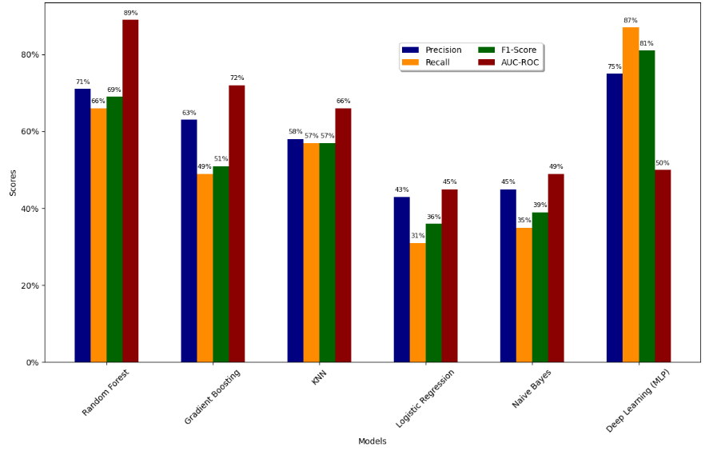
Model Metrics Comparison
Random Forest and Gradient Boosting are the top-performing models, with the former excelling across all metrics and the latter showing strength in Precision.
KNN and Logistic Regression show room for improvement, with Logistic Regression scoring the lowest across all metrics.
Despite decent performance from Naive Bayes and competitive results from Deep Learning (MLP), neither outperforms Random Forest or Gradient Boosting.
Notes:
The graph illustrates a detailed analysis of various predictive models, evaluating their performance based on key metrics such as precision, recall, f1-score, and AUC-ROC. Precision is critical for assessing the accuracy of positive predictions, while recall measures the model's ability to identify all relevant instances. The f1-score is a harmonic mean that combines precision and recall, offering a single measure of a model's accuracy. AUC-ROC, on the other hand, evaluates a model's capability to differentiate between classes. Comparing these metrics across models, we see that Deep Learning (MLP) has the highest precision and recall, suggesting it is the most accurate at identifying high-priced properties without misclassifying too many low-priced properties as high-priced. However, its AUC-ROC score is relatively low, which could indicate some issues in the model's ability to rank properties consistently.
In this analysis, the Random Forest and Gradient Boosting models emerge as leaders. Random Forest excels in all areas, demonstrating high accuracy, precision, recall, and an impressive f1-score, alongside a strong AUC-ROC value. Gradient Boosting also shows robust performance, particularly in precision, though it doesn't quite match Random Forest on other metrics. KNN and Logistic Regression show room for improvement, with Logistic Regression scoring the lowest across all metrics. Despite decent performance from Naive Bayes and competitive results from Deep Learning (MLP), neither outperforms Random Forest or Gradient Boosting.
In summary, while Random Forest stands out as the top-performing model across all evaluated metrics, Gradient Boosting holds its ground with high precision. KNN shows moderate performance, but Logistic Regression and Naive Bayes require improvements. The Deep Learning model, despite a competitive stance, needs additional analysis to optimize its performance.

Slide 19

Conclusion
Thank you for watching!
This Photo by Unknown Author is licensed under CC BY-NC

